Slide 1

BLUETOOTH CAR CONTROL USING ARDUINO

Slide 2
CONTENT
INTRODUCTION
SYSTEM DESIGN AND IMPLEMENTATION
ARDUINO PIN DIAGRAM
COMPONENTS
ANDROID APPLICATIONS
BUDGETS ESTIMATION
ADVANTAGES
FUTURE WORK
CONCUSION
REFERENCES

Slide 3
INTRODUCTION
Bluetooth control car app is used to send the signals and to receive signals.
Here Arduino acts as main controller of the device which sends these commands to motor driver to perform a particular task.
Develop an android app which allows the user to sends commands via Bluetooth.
Commands Received by Bluetooth modem (HC-05) connected to Arduino UNO.
Arduino Controls motor which allow the movement of robot.
Arduino Controls motor Which allows the Movement of Car

Slide 4
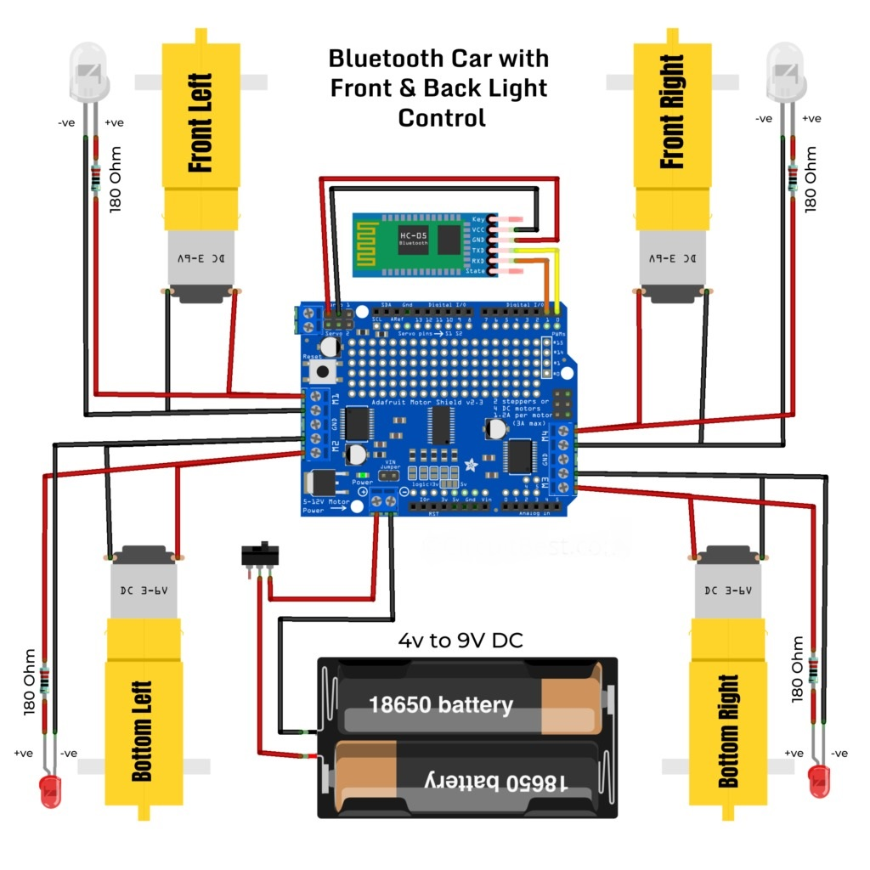
SYSTEM DESIGN AND IMPLEMENTATION
Solder and attach motors to the base.
Connect wheels to the motors.
Join to barriers in series.
Connect motors to motor driver.
Connect motor driver to Arduino.
Join Bluetooth module to Arduino.
Connect motor driver to battery
Circuit diagram of Bluetooth Controlled
CAR using Arduino, L293D AND HC-05.

Slide 5
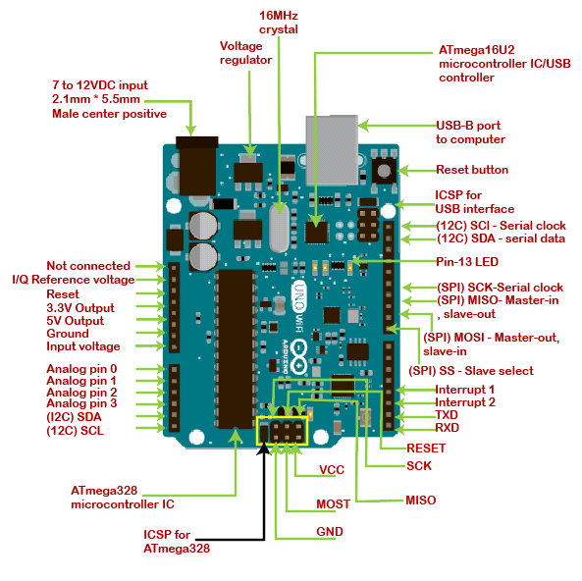
ARDUINO PIN DIAGRAM

Slide 6
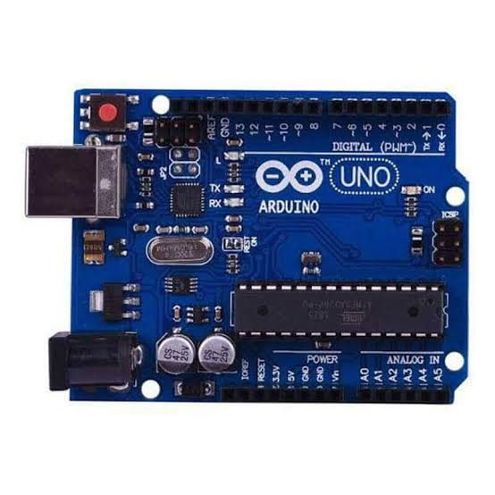
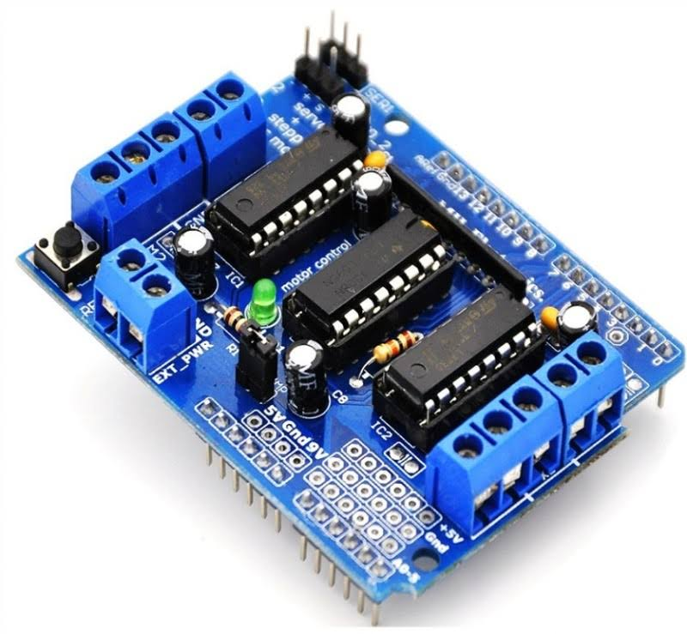
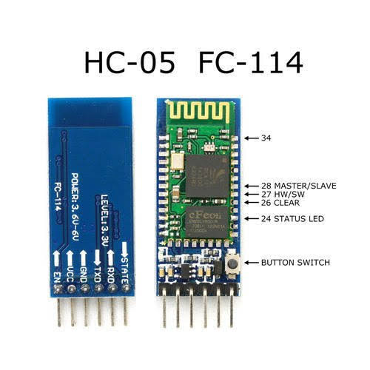
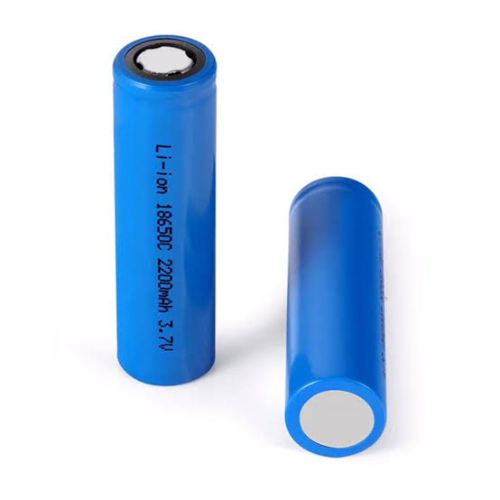
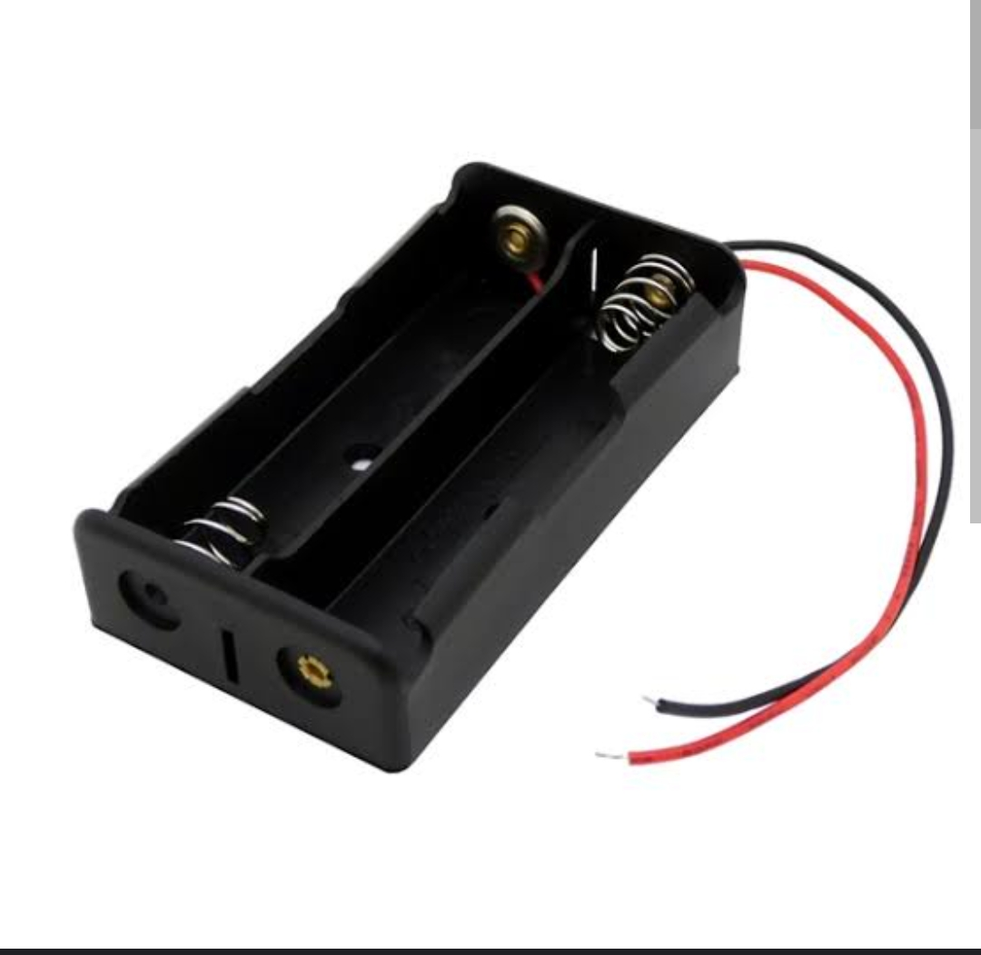
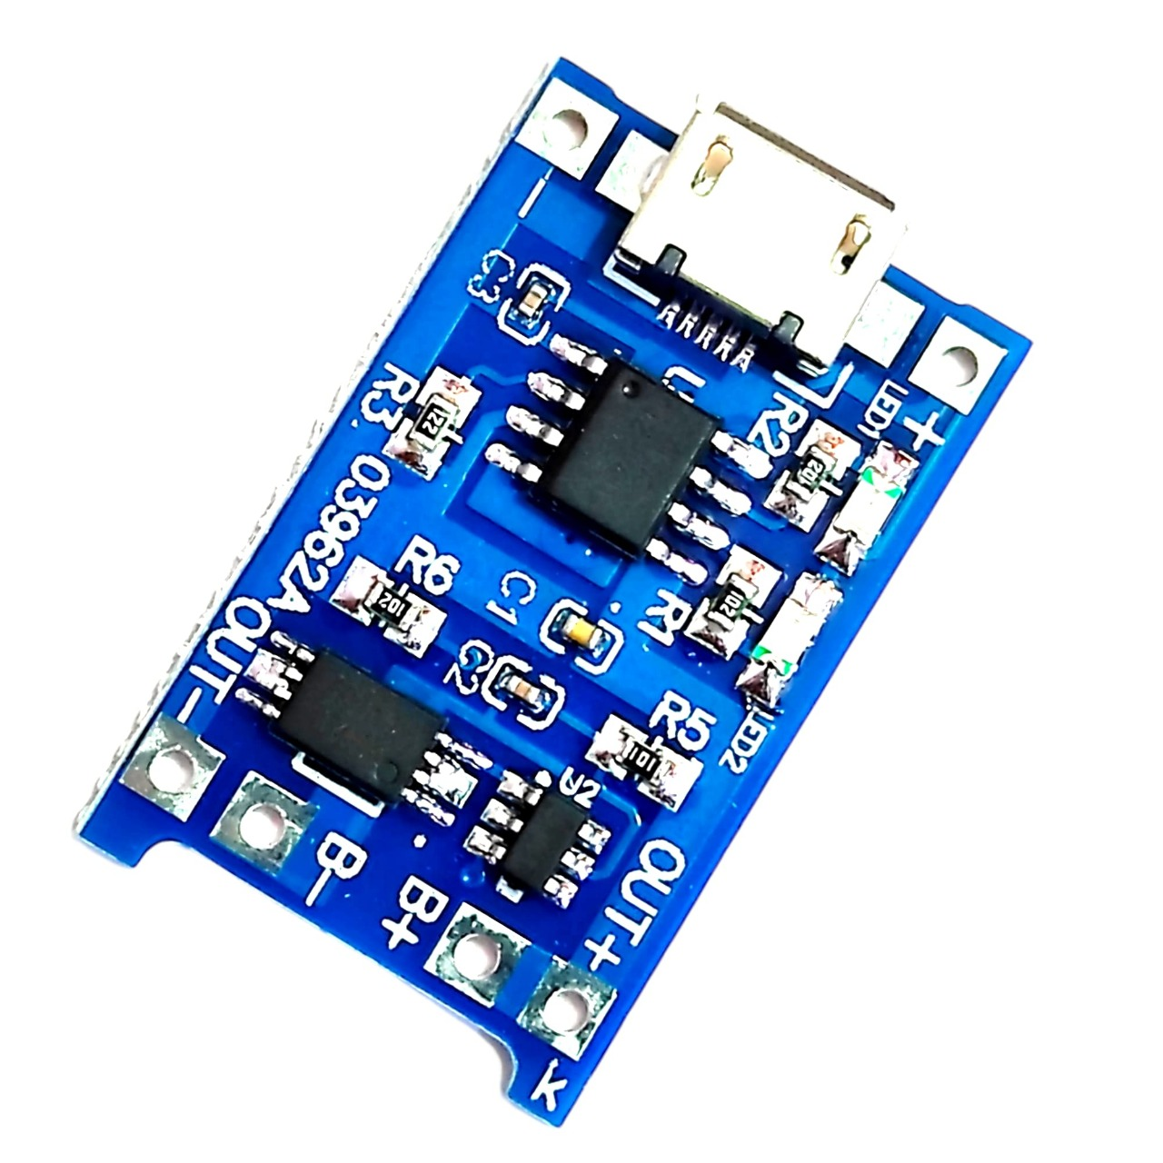
COMPONENTS
UNO ARDUINO
MOTOR DRIVER L293D
HC-05 BLUETOOTH
MODULE
LITHIUM –ION BATTERY
BATTERY HOLDER
5V CHARGER MODULE TP4056

Slide 7
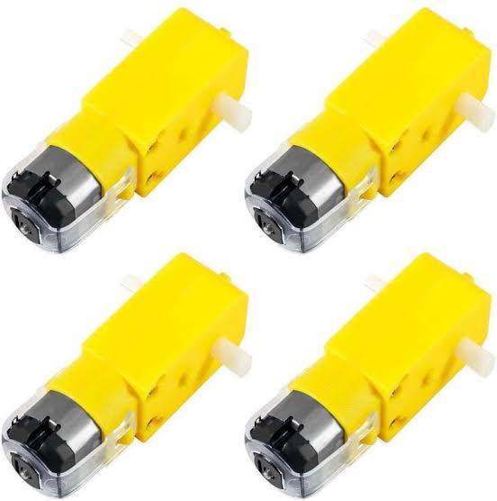
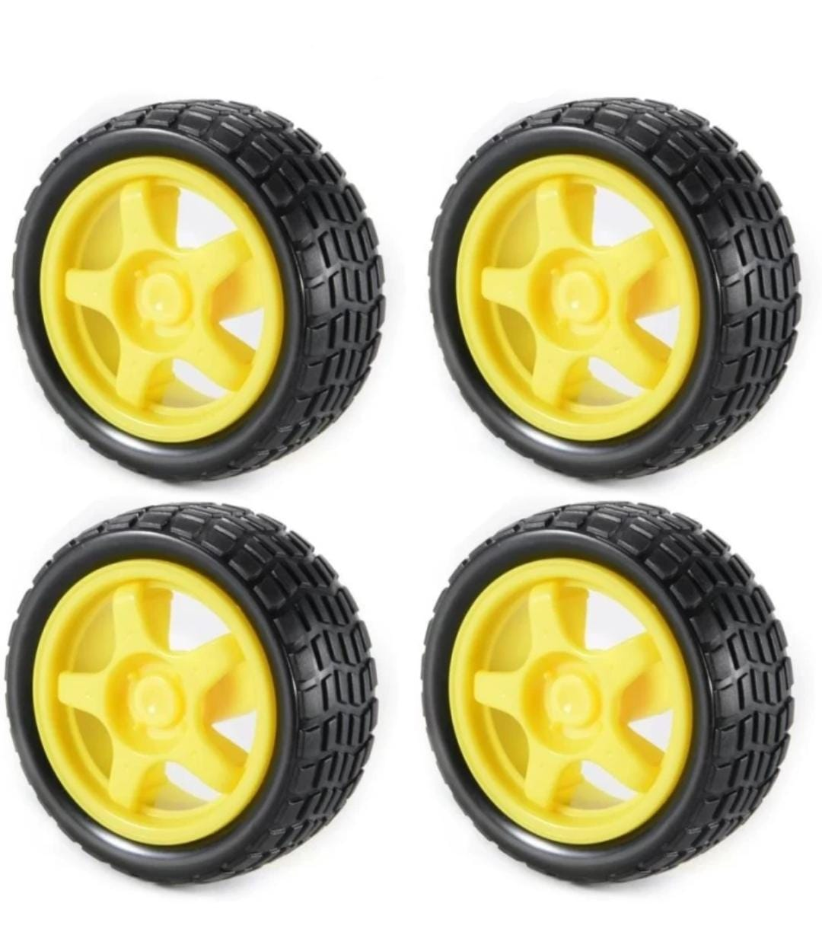
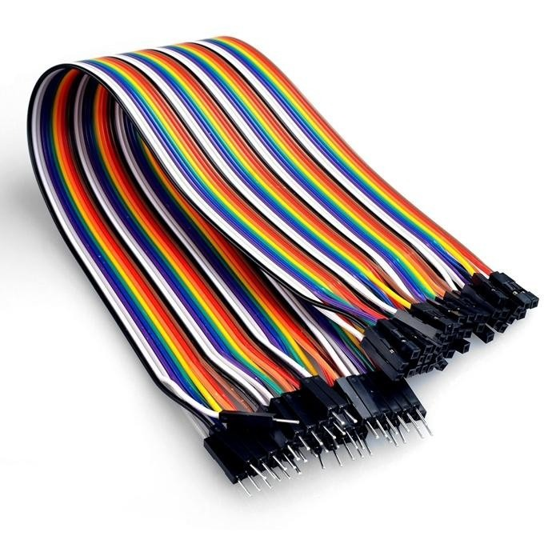
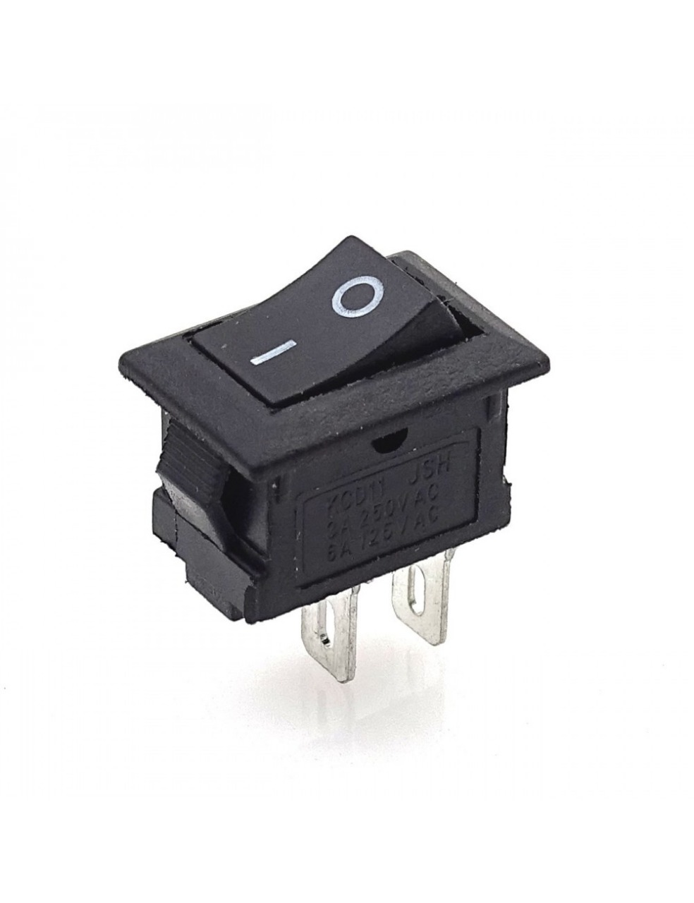
COMPONENTS
GEAR MOTOR
MOTOR WHEEL
JUMPER WIRE
DC SWITCH

Slide 8
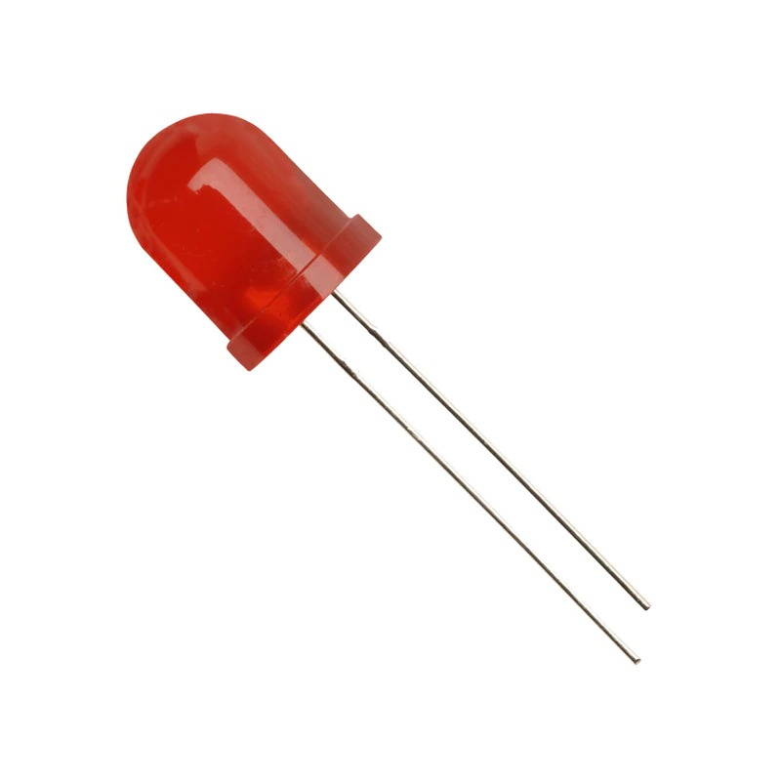
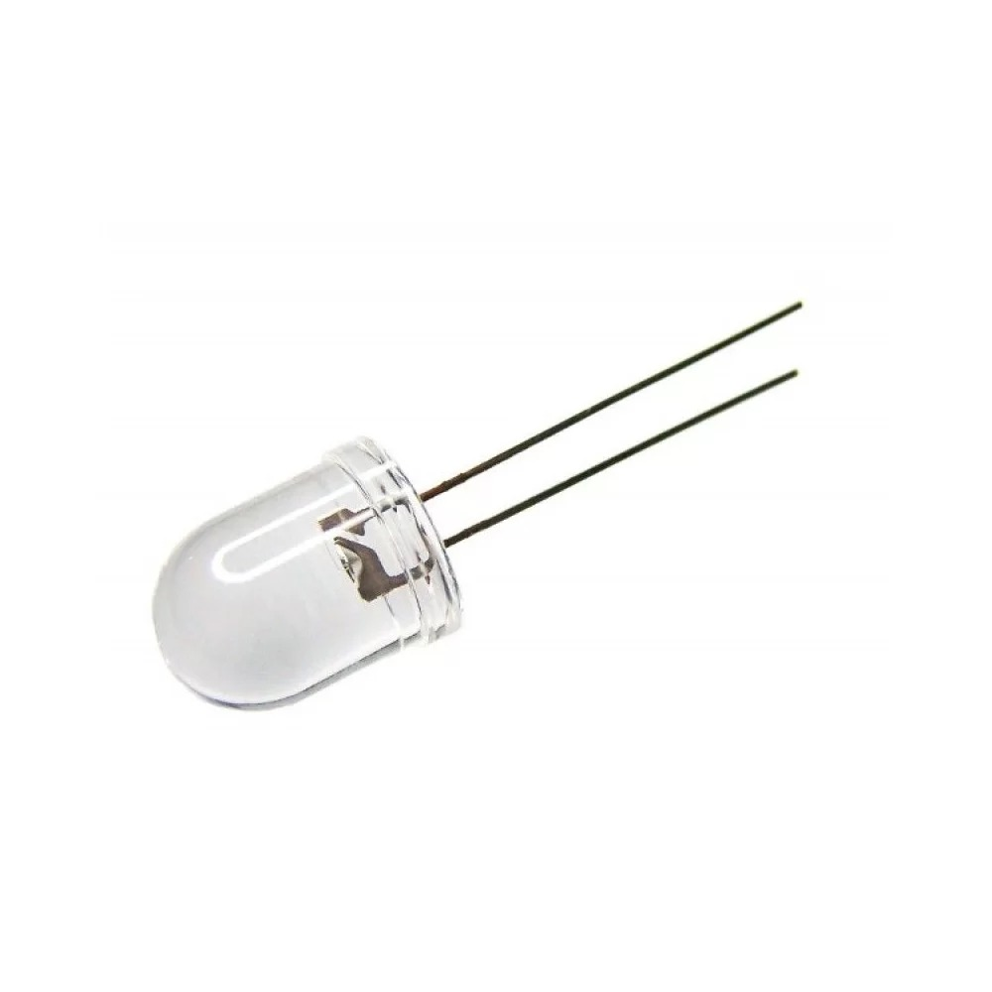
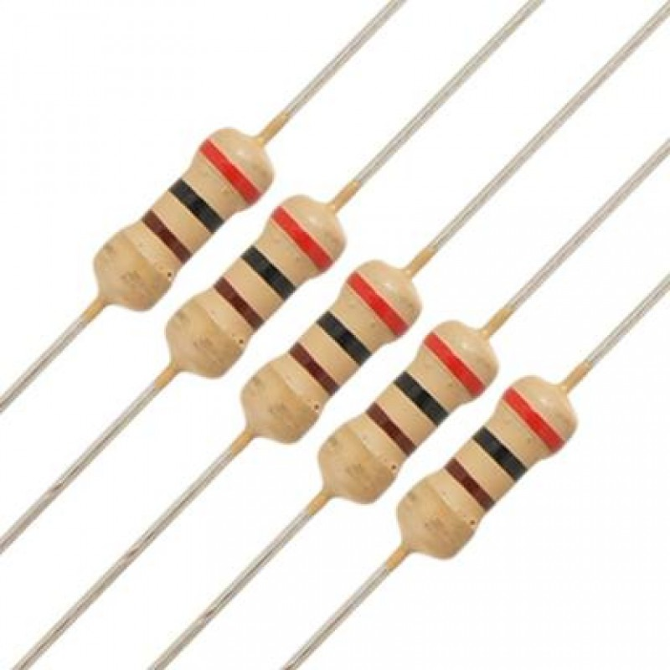
COMPONENTS
RED LED
WHITE LED
REGISTERS

Slide 9
BUDGET ESTIMATION
UNO ARDUINO – 650/-
MOTOR DRIVER L293D – 300/-
LITHIUM –ION BATTERY HOLDER – 100/-
LITHIUM BATTERY 2PIECE – 200/-
GEAR MOTOR AND WHEEL 4 PIECE – 500/-
HC-05 (FC-114) BLUETOOTH MODULE – 350/-
5V CHARGER MODULE TP4056 – 100/-
DC SWITCH – 10/-
JUMPER WIRE – 20/-
2 ACRYLIC PVC CAR CHASIS – 300/-
2 RED LED (10mm) – 10/-
2 WHITE LED (8mm) – 10/
4 REGISTER 180 ohm – 20/-

Slide 10
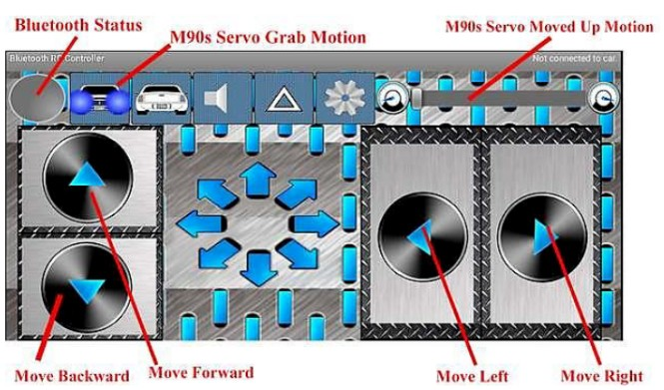
ANDROID APPLICATION
The HC-05 Bluetooth module connected to Android app called Bluetooth controller .
This app install easily on any Android smartphone to data transmission.
In this project we have used the same app with modifications in data to be transmitted.

Slide 11
ADVANTAGES
Wider range to control.
More efficiency.
Ability to change the remote at any time.
Physical barriers like walls and obstacle do not affect control.

Slide 12
FUTURE WORK
We can interface sensors to this car so that it can monitor some parameters.
We can add wireless camera to this robot.

Slide 13
CONCLUSION
This project consists of a basic prototype of a Bluetooth control car.
The prototype car can recognize commands from users.
It can be further improved by using different sensors like ultrasonic or infrared and with various levels of coding.
The range mostly depends on the receiver transmission level.. With the ever-increasing problems, our knowledge has to expand to adapt better to the changes all around us.
In the same way, it is hoped that this activity is a small step that would lead us to further enhancements and goals

Slide 14
REFERENCES
Wang, B.Y. (2009) Summary of IoT Technology Research. Journal of Electronic Measurement and Instrument, 12, 1-7.
J. Gubbi, R. Buyya, S. Marusic, M. Palaniswami, Internet of things (IoT): a vision architectural elements and future directions, Future General. Computer. Syst. 29 (7) (Sep. 2013) 1645–1660.
A. Ibrahim, D. Ibrahim, Real-time GPS-based outdoor Wi Fi localization system with map display, Adv. Eng. Software. 41 (2010) 1080–1086.

Slide 15
THANK YOU

